Slide 1
Beating the Baseline
West Nile Virus Prediction in Chicago

Slide 2
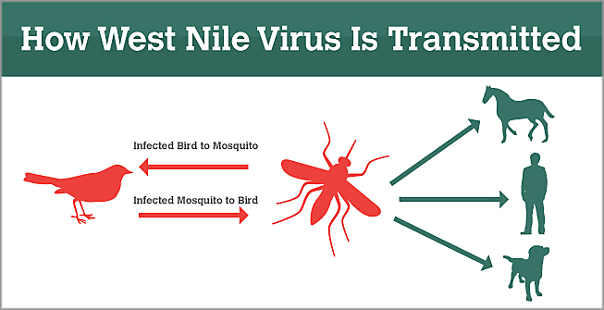
West Nile Virus
Most common mosquito-borne disease in U.S.
80% of people infected will not show any symptoms.
Common: Flu-like
Severe: fatal neurological disease
Mainly transmitted to people through mosquito bites
Vaccines not yet available for human use
Risk of increased exposure with climate change
Increased temperatures
Increased disease incubation & biting rates
Notes:
West Nile Virus- Most common mosquito-borne virus US
80% of those infected do not develop symptoms
Of The 20% that do- symptoms are commonly flu-like
However, a minority of those individuals can develop a fatal neurological disease
The image to the left details the paths of transmission for the virus
Birds are the natural hosts, who then transmit to mosquitoes- who then transmit to humans and other animals including horses and dogs
While Vaccines are available for horses, they are not currently available for human use
Therefore,
An accurate method to predict when/where virus will spread
Only option for prevention

Slide 3
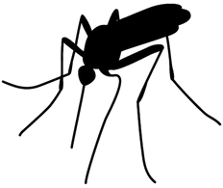
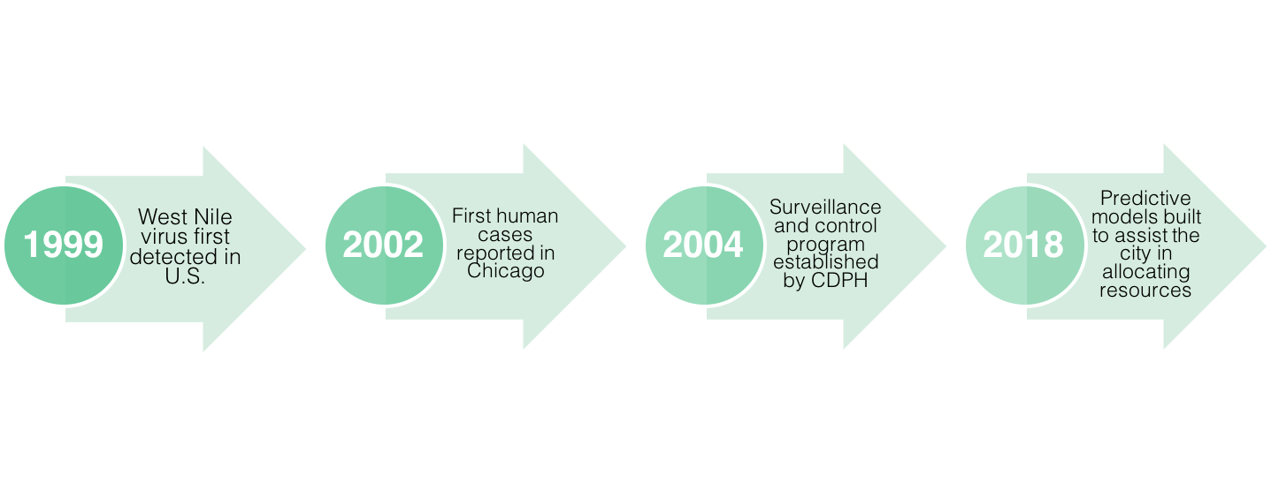
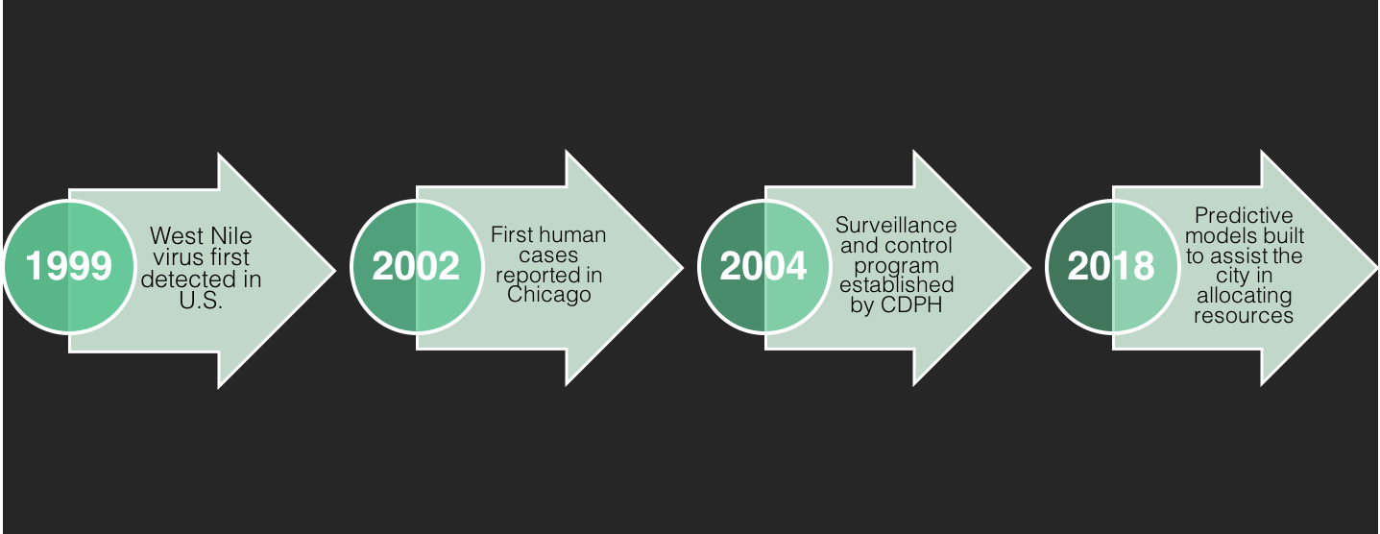
West Nile Virus in Chicago Timeline
Notes:
To give a brief timeline of the virus’ history:
The first case of Wnv in the US was detected in 1999
Not long after in 2002, the first human cases of the virus were reported in Chicago
Responding quickly to the outbreak, by 2004 the City of Chicago and the Chicago Department of Public Health established a surveillance and control program that is still in effect today
From late to early fall
A number of mosquito traps are placed throughout the city
Each trap is then tested for the virus
The results of these tests dictate where the city will spray pesticides
-Move a bit further down the timeline to 2018
- Our team utilized weather, location, testing, & spraying data
- in order to build predictive models
-to assist city in effectively/efficiently allocating resources dedicated to prevention

Slide 4
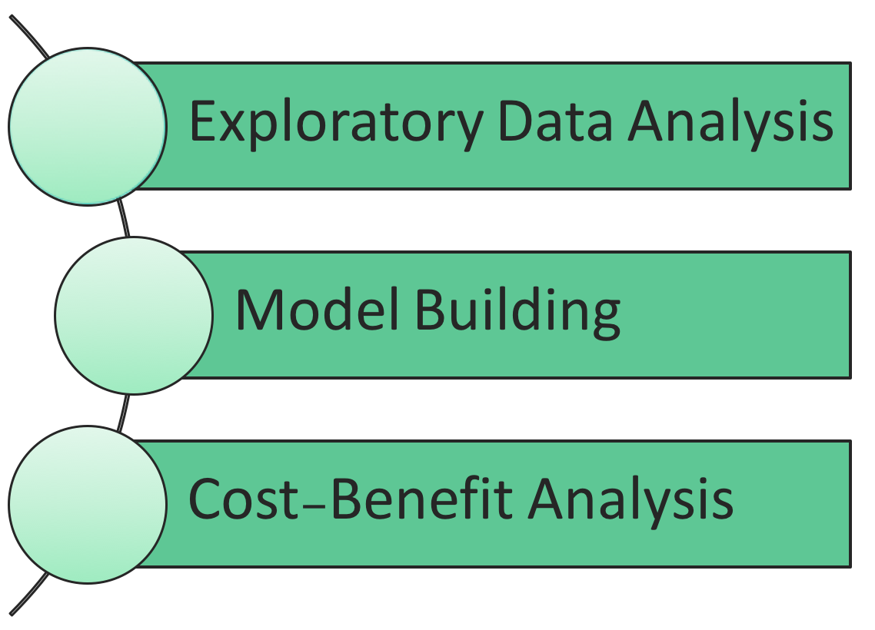



Notes:
Today our team will take you through:
Our Exploratory data analysis
Model building process
Cost-benefit analysis
In Hopes to demonstrate that proactive methods will be most effective in
Preventing the spread of West Nile virus in Chicago

Slide 5
Exploratory Data Analysis

Slide 6
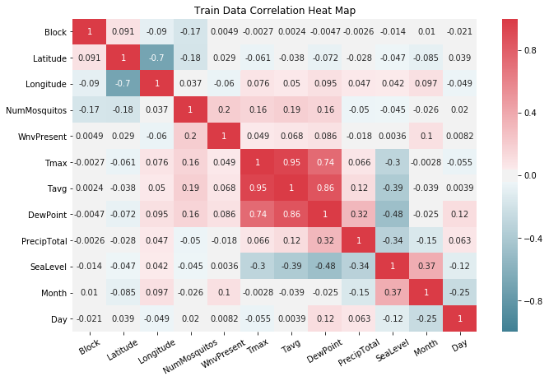
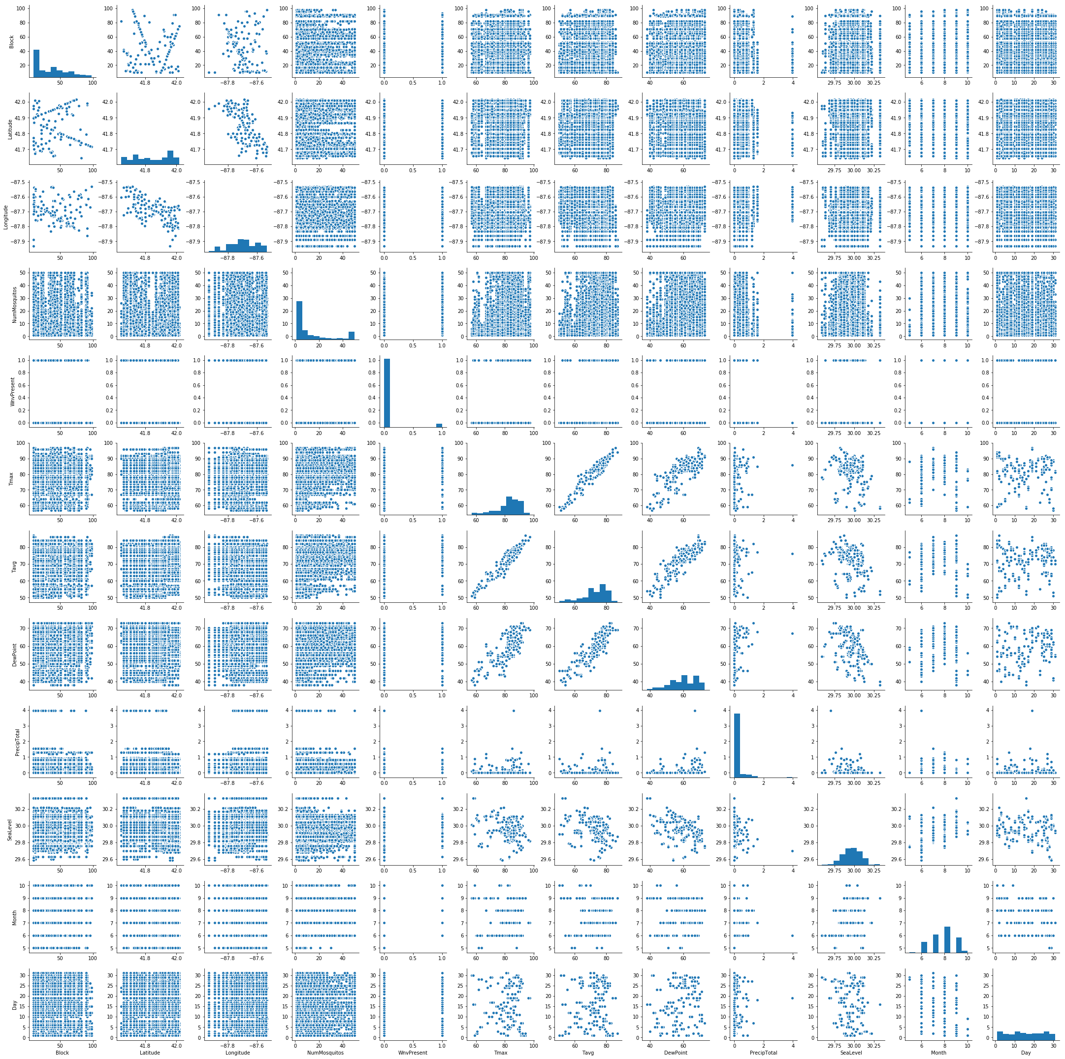
Exploring Correlation
Notes:
Positive skew = Blocks, NumMosquitos, and PrecipTotal (mean > median > mode)
Negative skew = Tmax, Tavg, and DewPoint (mean < median < mode)
Normal = Day, Month, Sea Level, Longitude, and Latitude
WnvPresent binary, more 0 than 1 = baseline going to be high
Columns NumMosquitos, Tmax, Tavg, DewPoint, SeaLevel, Month, and Day shows the positive relationship to WnvPresent.

Slide 7
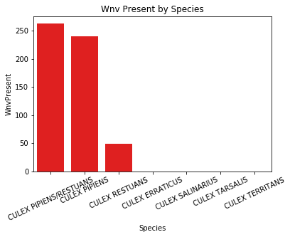
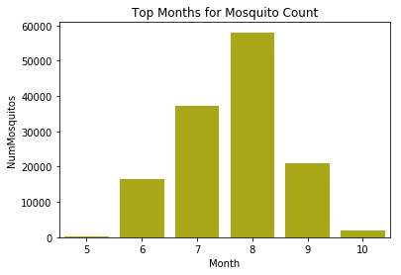
Exploring Count
Notes:
Top 3 species = CULEX PIPIENS/RESTUANS, CULEX PIPIENS, CULEX RESTUANS.
Mosquito population drastically increases from July to August and drops significantly in September.

Slide 8
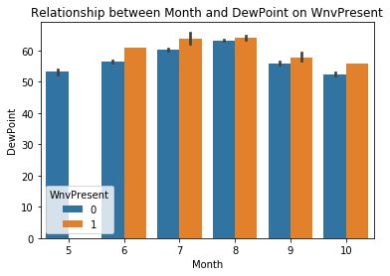
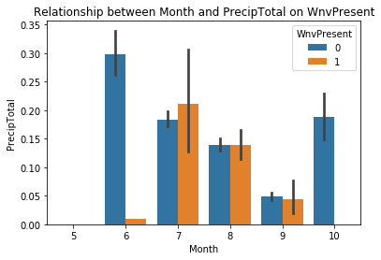
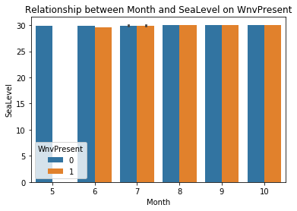
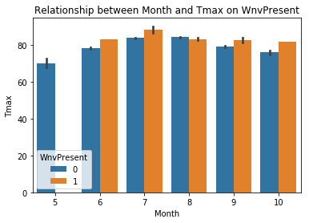
Exploring Factored Relationships
Notes:
West Nile virus seems to thrive at high temperature and high moisture level.

Slide 9
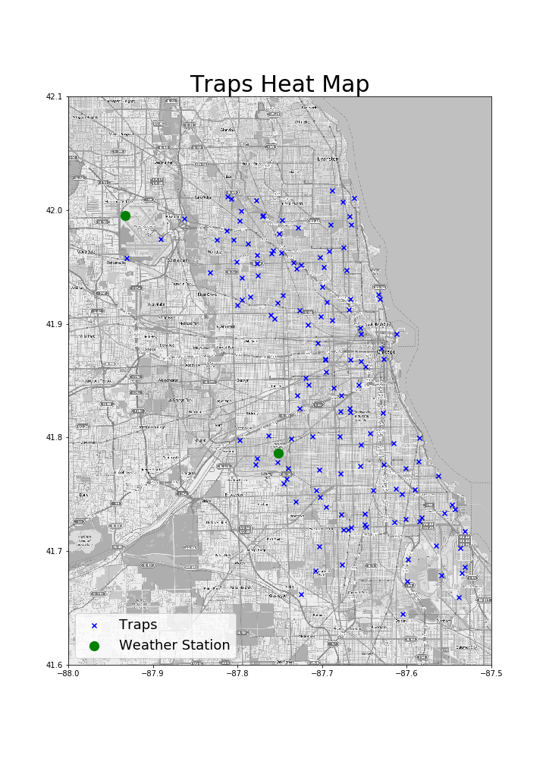

Slide 10
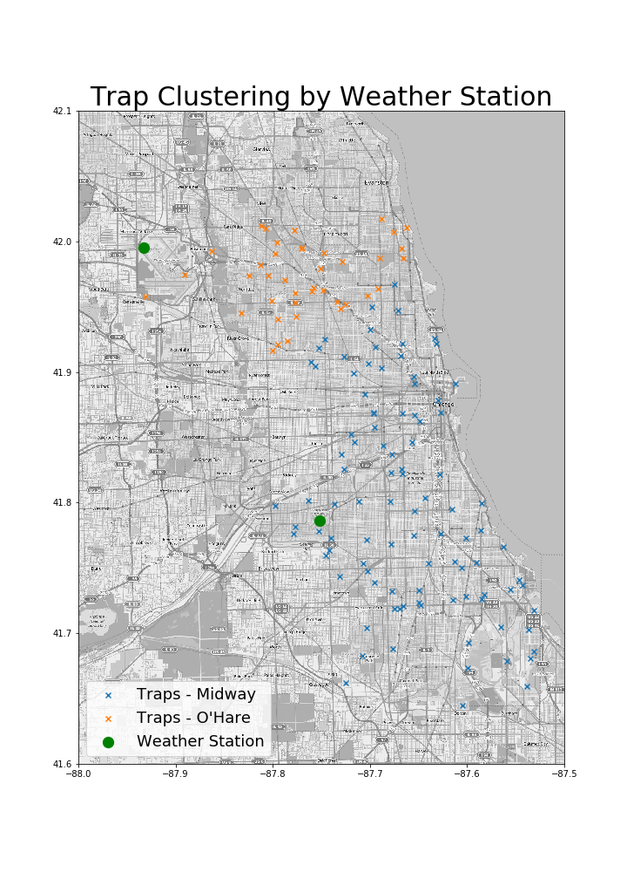

Slide 11
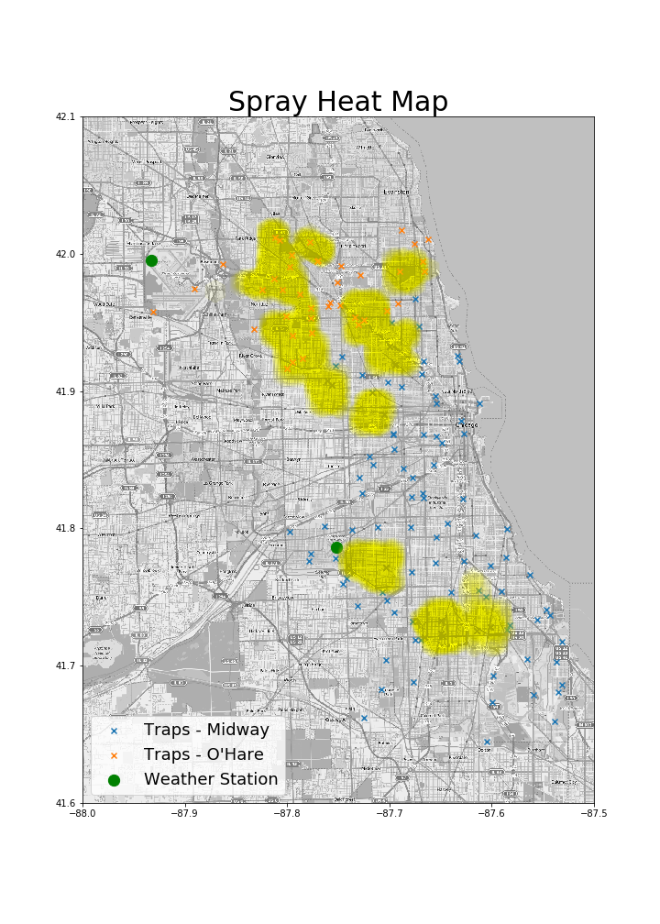

Slide 12
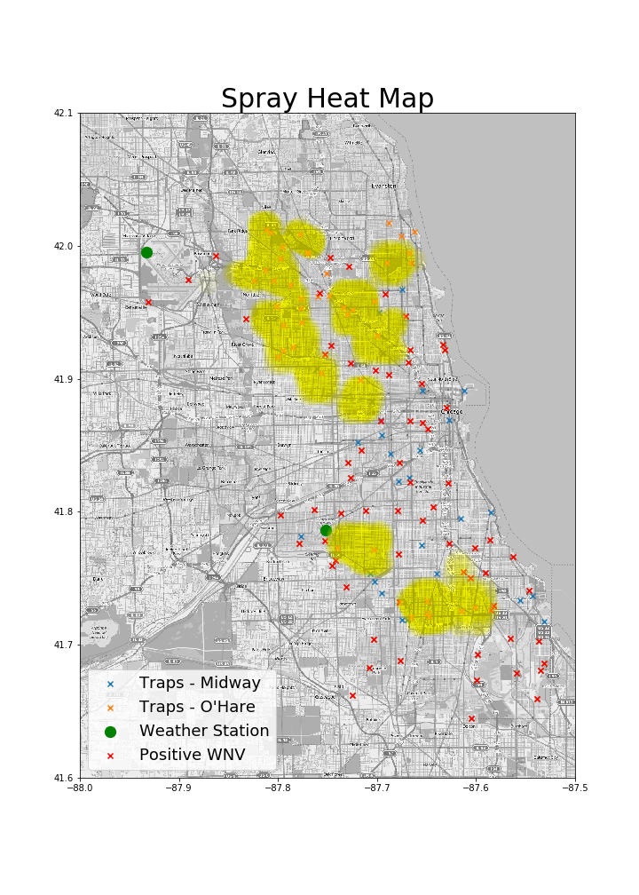

Slide 13
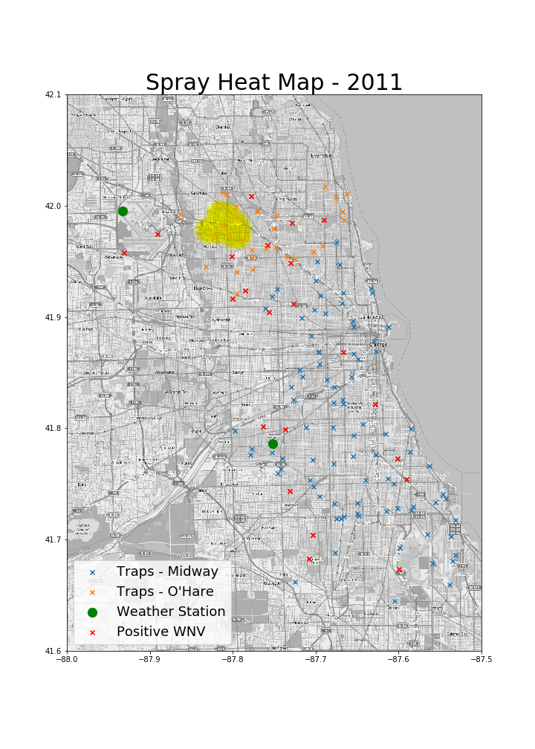
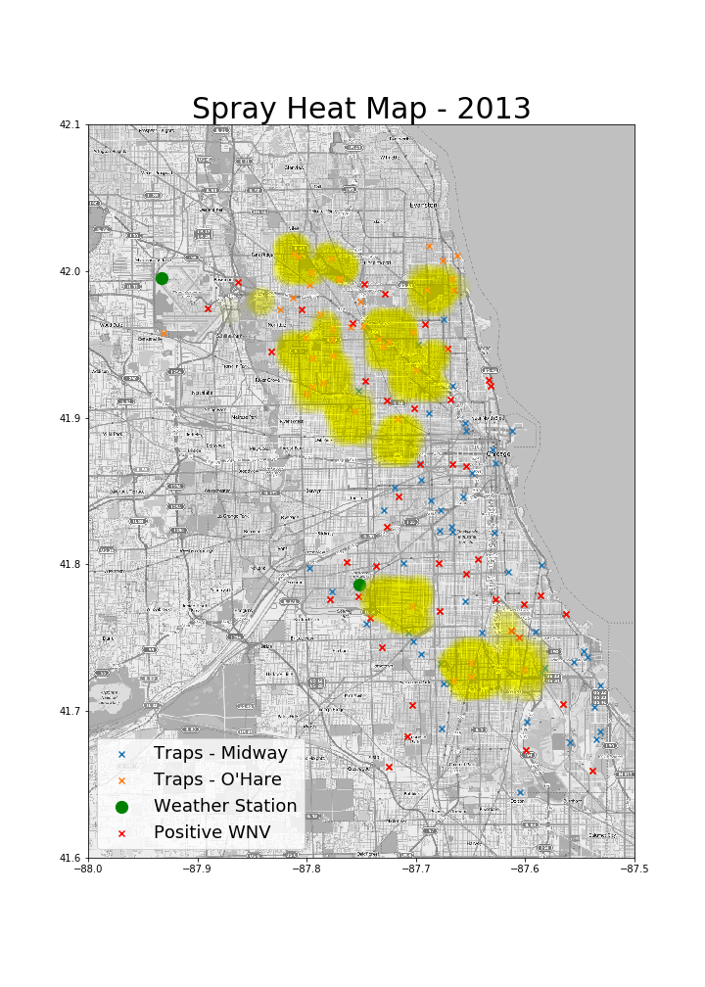

Slide 14
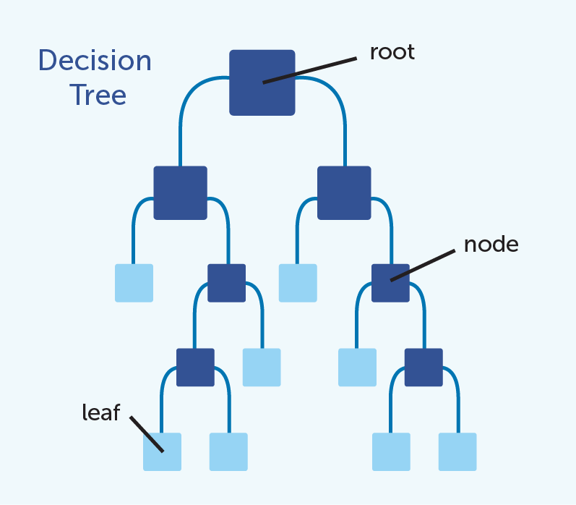
Notes:
Each split in the branch, where we break the large group into progressively smaller group by posing an either-or scenario, is referred to as a node. The terminal node is called a leaf.
The model will make decisions at each node starting with the root to split the data on a select feature, selecting a new feature at each node. Using this method, the model is trying to separate the data into categories to best predict the desired target variable

Slide 15
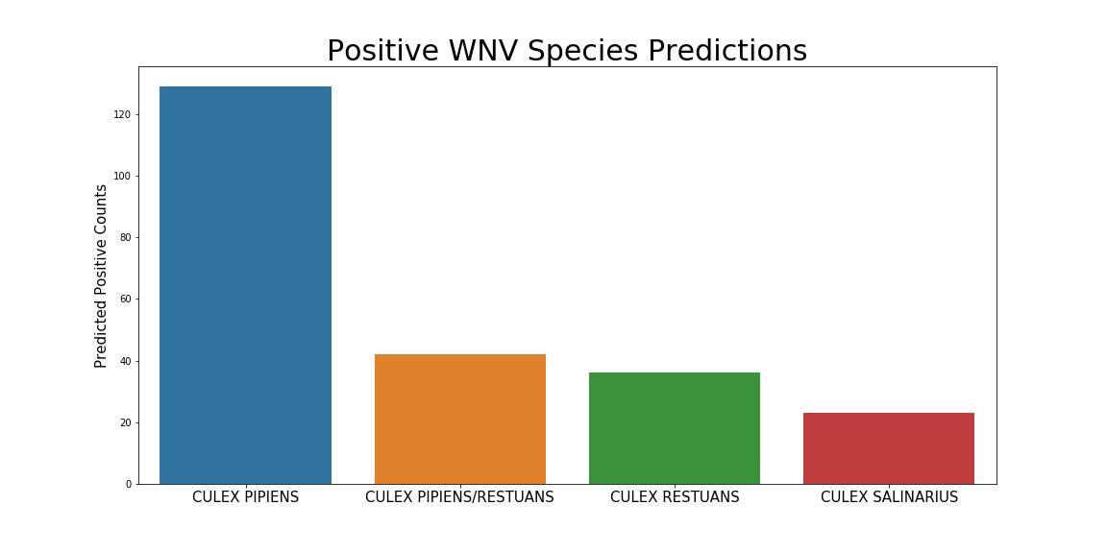
Notes:
Model predictions for WNV positive mosquito species
56% - Culex Pipiens
18% - Culex Pipiens / Restuans
16% - Culex Restuans
10% - Culex Salinarius

Slide 16
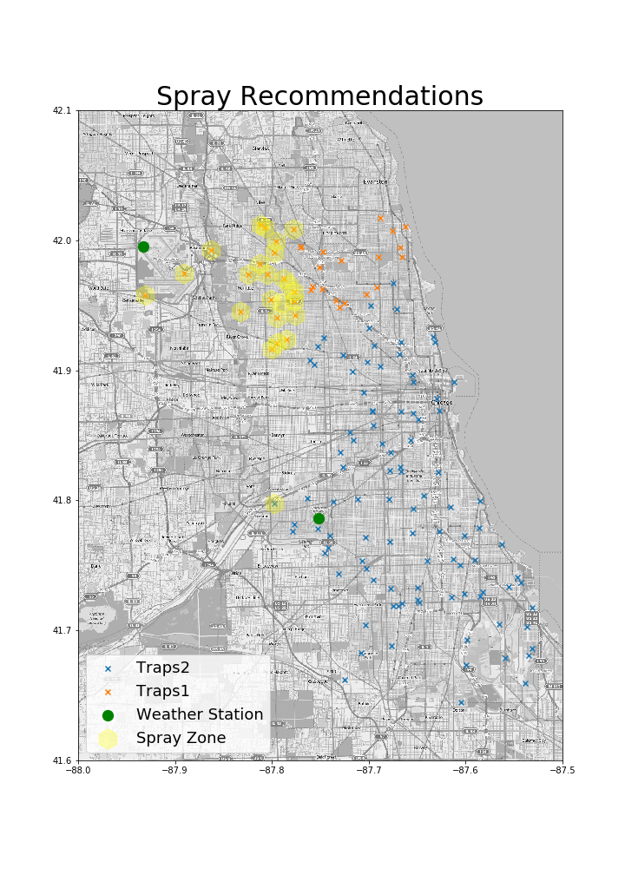
Notes:
Model recommends spraying the 2 square mile zone directly Southeast of the O’Hare International Airport

Slide 17

Cost Benefit
ANALYSIS

Slide 18
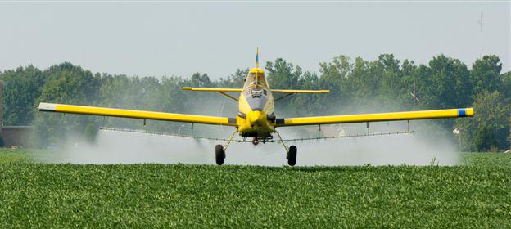
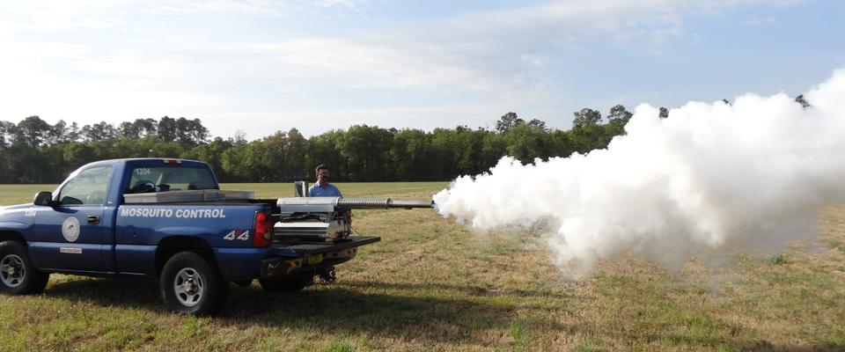
Vector Control
Truck Mounted vs. Aerial Spraying
Size of Treatment Area
Timing & Biology
Wind Speed & Direction
Dispersion Speed
Organophosphate vs. Synthetic Pyrethroid Pesticides
EPA registered - effectiveness & safety
Per acre cost: $0.43 vs $2.14
Common use since 1950s - Naled
Notes:
Vector control is any method to limit or eradicate the mammals, birds or insects that transmit disease pathogens.
The 2 most common forms of vector control for mosquitoes are truck mounted and aerial spraying, which are pretty self explanatory.
There are many factors to consider when directing vector control efforts that include but are not limited to:
Timing (mosquitoes active- early evening)
Wind speed/direction (relies on being carried thru air <10mph)
Vector Disease Control International specifies
Factors have bigger impact on truck mounted spraying efforts
Aerial- more effective in rapidly reducing # mosquitoes spreading virus in large areas
City of Chicago- 2017 spraying efforts- limited to truck mounted
Recommendation to implement aerial spraying
Organophosphates vs Synthethic Pyrethroid
Cheaper of two options, Naled used ext. In US
Applied to 16 million acres annually
Commonly used in disaster situations
Breaks down immediately given sunlight and water

Slide 19
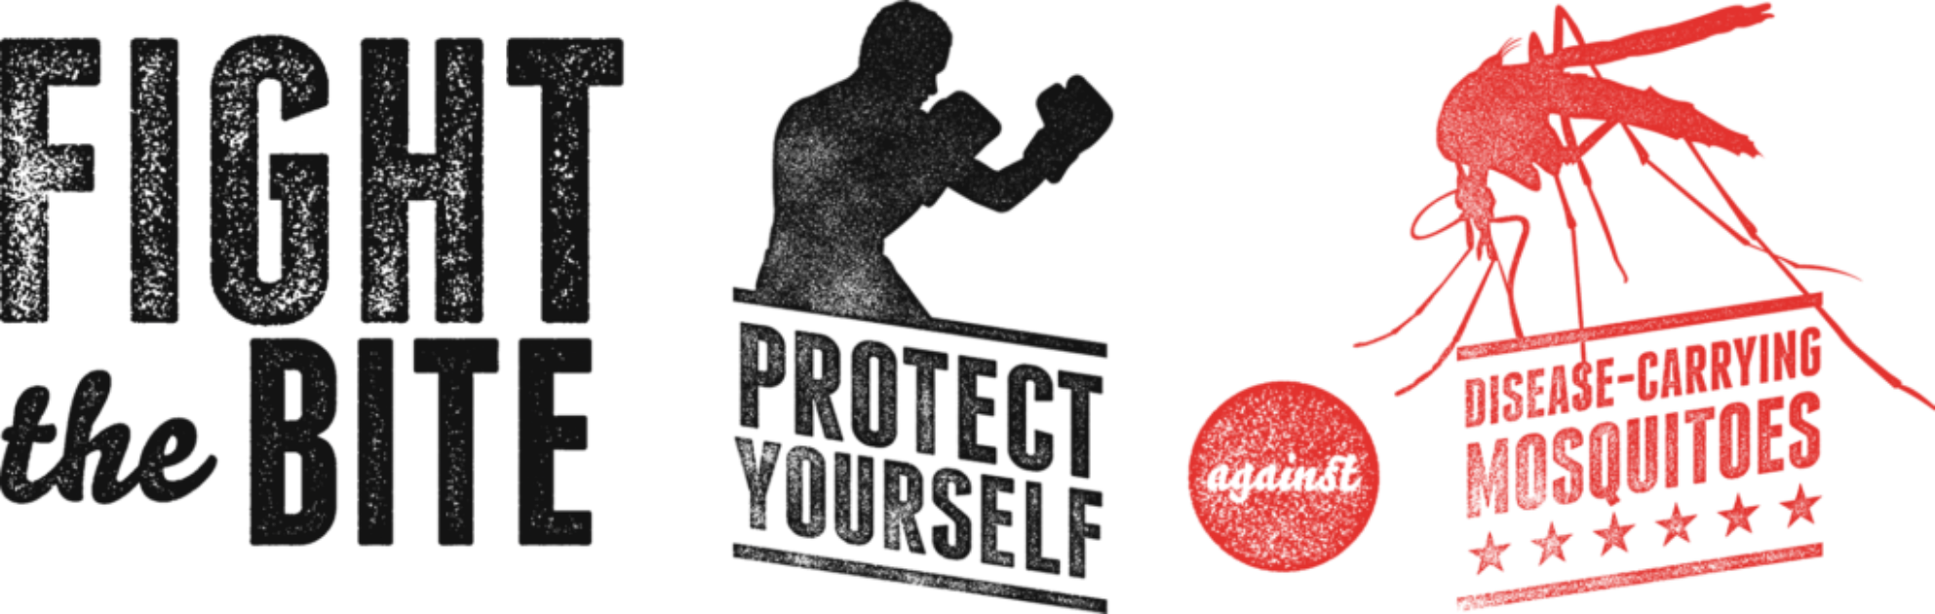
SACRAMENTO
163 Cases Reported
Vector Control Cost : $660,000
Medical Cost
$ 33,143 per inpatient
$ 6,317 per outpatient
$ 18,097 per nursing home patient
Productivity Loss
$ 10,800 per patient < 60 years
$ 7,500 per patient > 60 years
TOTAL COST = $
$2,844,338 Medical and Productivity Loss
$2,979,037
OTHER AREAS IN ILLINOIS
Itasca
Vector Control Cost 2015 : $70,508
$ 13,907 per square mile
Northwest Mosquito Abatement District
Vector Control Cost 2015: $2,300,000
$9,536 per square mile
Covers 24 suburban districts
Addison Township
Vector Control Cost 2015: $41,455
$1,278 per square mile
Notes:
Case Study: Our team utilized 2 case studies when performing a cost benefit analysis for Chicago’s vector control
- A WnV outbreak from 2005 in Sacramento, CA
- Spraying efforts from Itasca in 2015- a city also in Illinnois
- This slide details the costs for those efforts
In Sacremento:
-Vector Control $660,000
Includes plane, pilot, and application
Overtime expenses for Labor was an additional $41,790
Medical & Productivity Loss nearly $3M
This made up a majority of the costs!
Shows how much an emergency situation will inflate expenses.
Other, Smaller Cities in Illinois
If we applied Itasca’s regular spending to the target spray area in Chicago, it would cost $445,024
The only additional expense to factor in would be the additional labor needed for the increased coverage area (Itasca’s is only 5 sq miles)
If we applied NW Mosquito Abatement District costs to Chicago it would be $309,920, and it encompasses far more square mileage than the targeted spray areas, so the labor that the city of Chicago would need is arguably less.
Addison Township has the square mileage of the spray area covered in Chicago, and we can see what the costs approx would be.

Slide 20

Cost and Benefit Comparison
Chemical Costs are inexpensive
Organophosphates average is $0.43 per acre treated
Synthetic Pyrethroids average $1.43 - $ 2.85 per acre treated
Overtime Labor is expensive
The overtime labor for Sacramento costs $41,790
The TOTAL vector control cost for an area the size of the spray area in Chicago was $41,455
Medical Costs and Productivity Loss are very expensive
3:1 ratio of medical expenses to vector control and administrative expenses in Sacramento
Notes:
BRITT READ: UP UNTIL MEDICAL COSTS…
LAUREN READ MEDICAL COSTS AND PRODUCTIVITY...

Slide 21
Recommendations
Notes:
Ultimately, our team believes that a comprehensive proactive approach is the most cost effective way for the city of Chicago to address the issue of containing the West Nile Virus
Both the CDC and the VDCI websites detail that
-chemical cost of either type of pesticide is relatively inexpensive
Case studies- Emergency Response in Sacramento reveals that
-most expensive component to the total cost of their WnV outbreak was
-Medical costs for those infected
-coupled with the crippling emergency costs of overtime pay
Chicago can avoid these expenses using preventative measures
- in order to optimize the benefit from a spray we recommend a transition from:
-truck mounting spraying to
-aerial fogging
- consideration factors, such as Size of treatment area, timing/biology, Wind speed/direction ,Dispersion speed have a lesser impact on the effectiveness of the spray itself.

